Slide 1
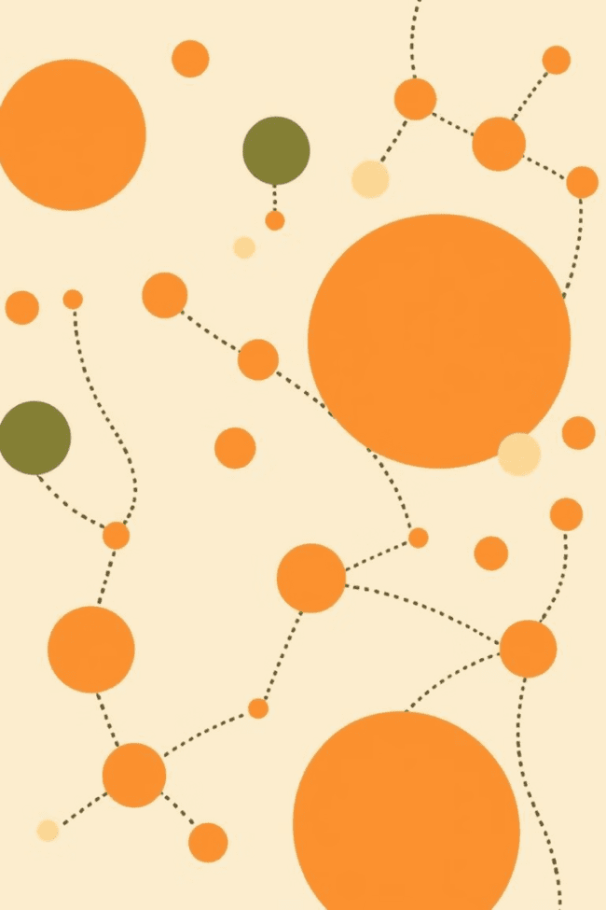

Dot Connect Game: A Python Project
Welcome! This presentation showcases my final Python programming project: "Dot Connect," a visually engaging game I developed. This project was a challenging yet rewarding experience, allowing me to apply various programming concepts and techniques to create a functional and enjoyable game. I will be discussing the game's objective, features, design, and technical implementation in detail throughout this presentation. I hope you enjoy this exploration of my work!

Slide 2
Introduction to the Game
Dot Connect Gameplay
Game Objective
Players connect dots of the same color to form lines. Points are awarded based on line length.
The aim is to clear the board by connecting all dots of the same color. The game ends when all dots are connected.

Slide 3
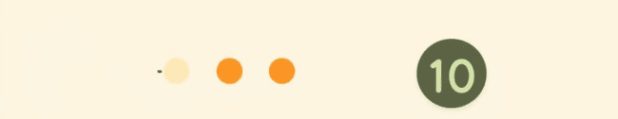
Objective and Rules of the Game
1
Rule 1
2
Rule 2
3
Rule 3
Players click and drag a line to connect dots of the same color.
Lines can be horizontal, vertical, or diagonal, forming various shapes.
Players score points based on the length of the lines they create.

Slide 4

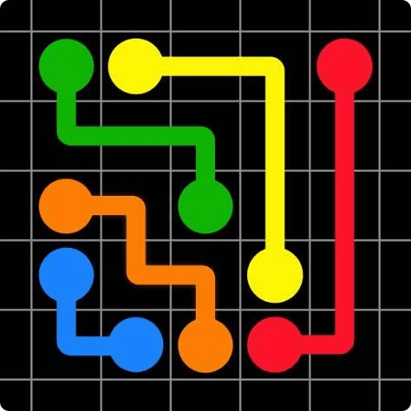
Key Features and Functionalities
Levels
Timer
The game offers multiple difficulty levels with increasing complexity.
A timer adds an element of urgency, challenging players to connect dots efficiently.
Scoreboard
Players can track their progress through a scoreboard that displays their score and time.

Slide 5

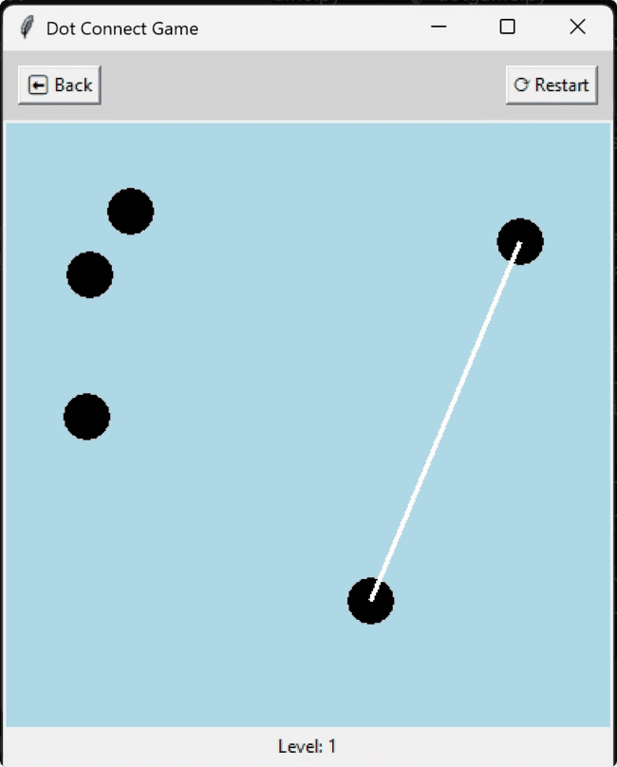



Game Interface and User Experience
Mouse Interaction
The game is designed to be mouse-driven, making it intuitive and user-friendly.
Menu Navigation
Players can access different game features through a simple and straightforward menu system.
Visually Appealing
The game uses vibrant colors and clear graphics for a visually engaging experience.

Slide 6
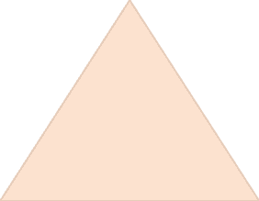
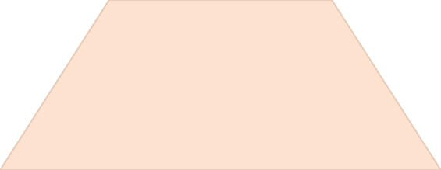
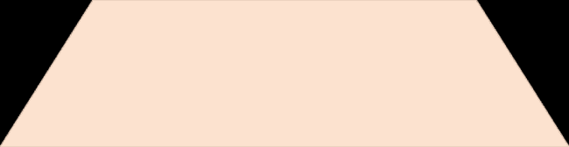
Technical Implementation Details
1
Python
2
Pygame Library
Used for graphical interface and handling user inputs.
Object-Oriented Programming
3
Used for structuring the game logic and defining game objects.

Slide 7
Data Structures and Algorithms Used
1
Arrays
Used to store information about dots and their positions on the grid.
Matrices
2
Representing the game board, storing information about the connections between dots.
Algorithms
3
Implementing game logic, such as line drawing and point calculation.

Slide 8
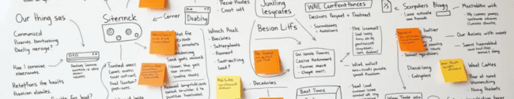
Challenges and Troubleshooting
1
2
3
Collision Detection
Performance Optimization
User Interface Design
Ensuring lines don't overlap or intersect incorrectly.
Maintaining smooth gameplay with a large number of dots.
Creating a user-friendly and intuitive game interface.

Slide 9


Lessons Learned and Future Improvements
User Feedback
Team Collaboration
Gathering feedback from players is essential to refine the game's design and gameplay.
Working in a team allows for shared knowledge and diverse perspectives.

Slide 10

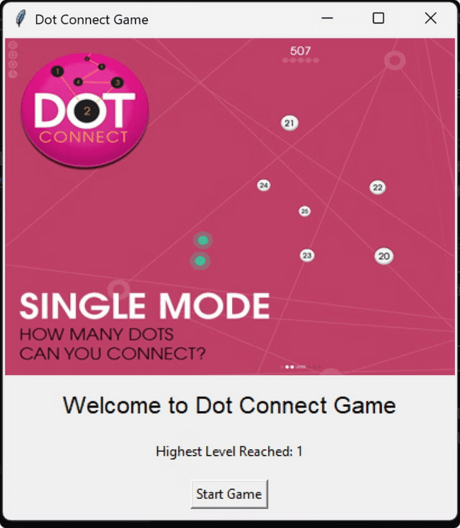
Demonstration of the Game
I'll now provide a live demonstration of the Dot Connect game, highlighting its key features and gameplay.

Slide 11
Thank You
By Shivraj(12305822)

